Slide 1
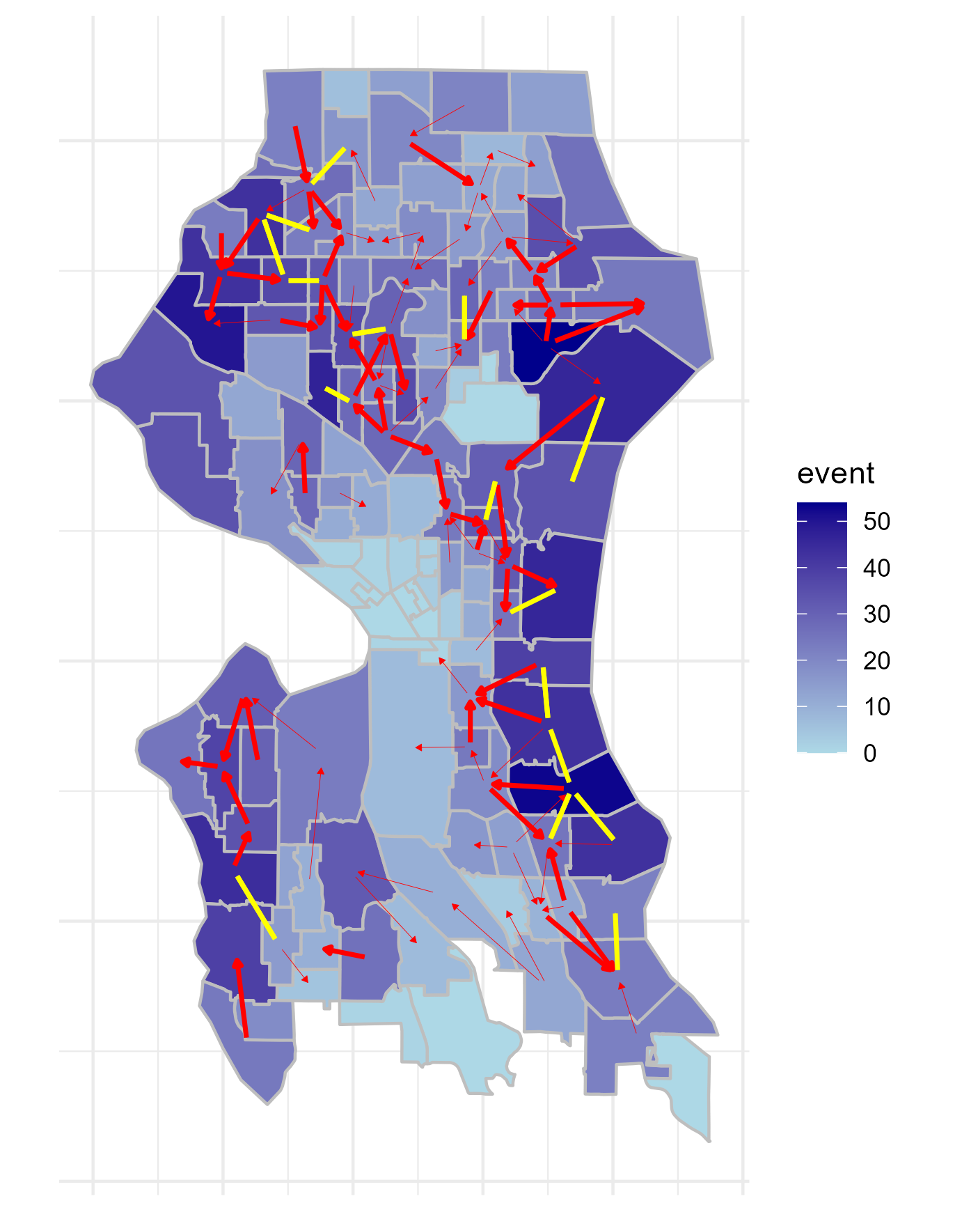
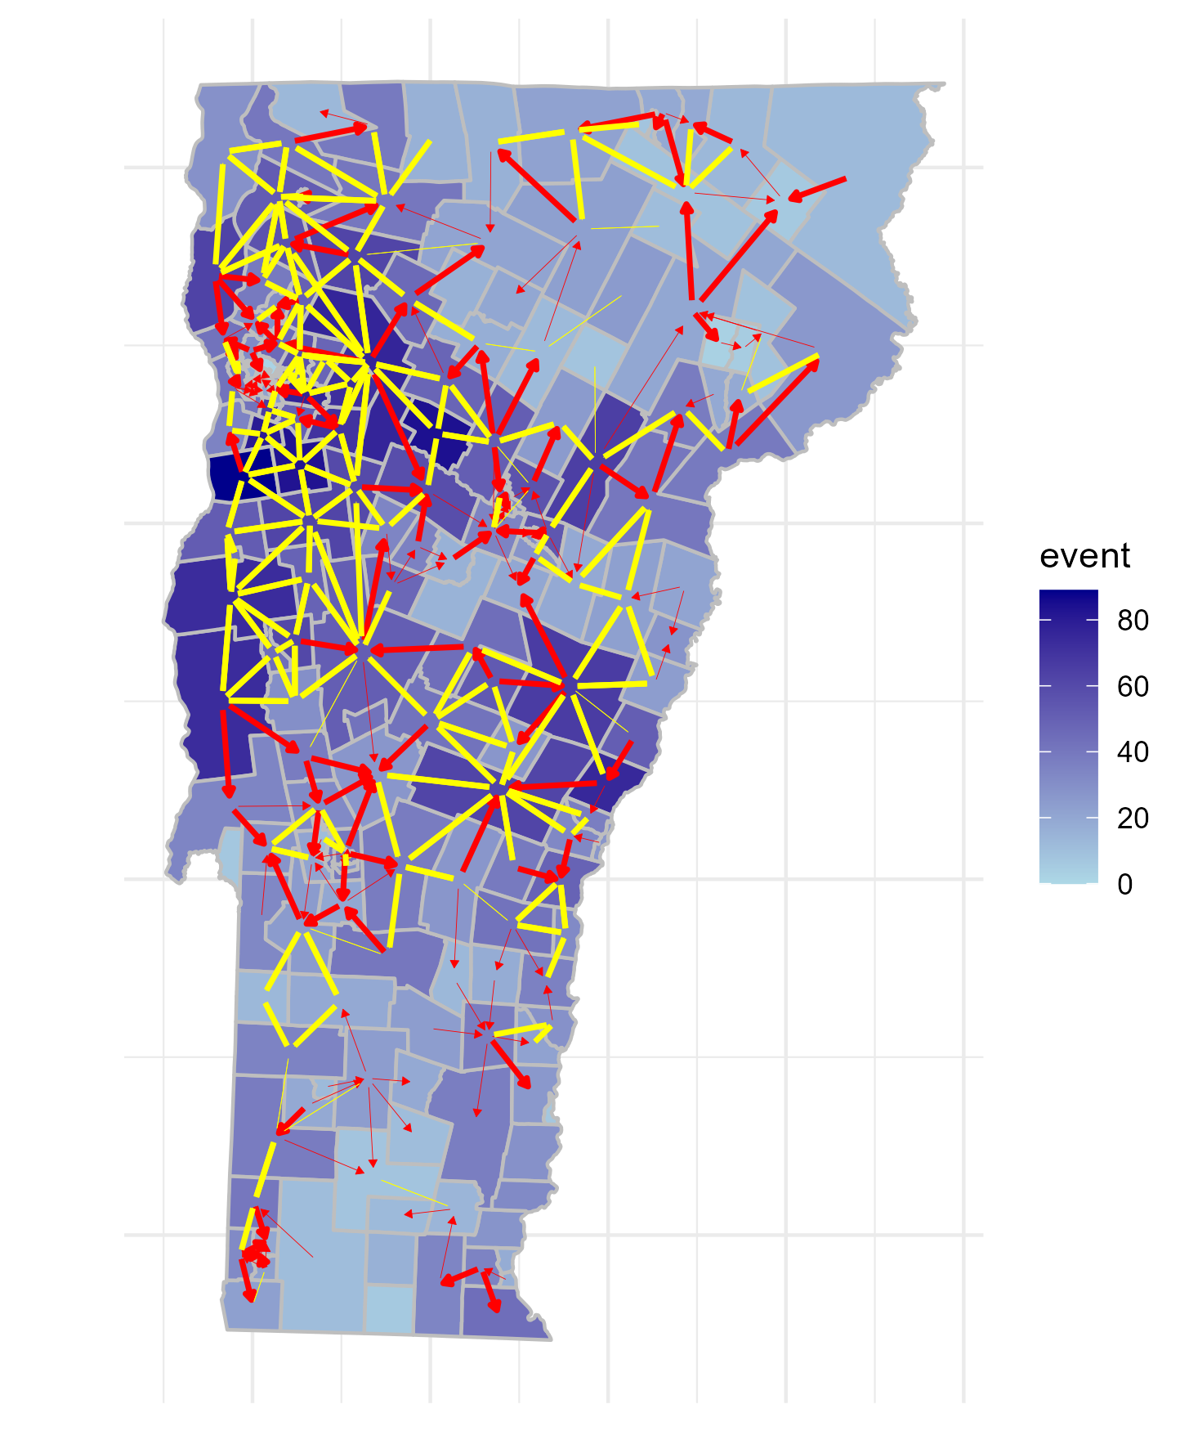
TE histogram?
ADD % of red vs yellow
Zoomed-in map in the dense part
Perhaps list of network properties?
Spatial scale bar
One-way causal flow with high TE
Two-way causal flow with high TE
One-way causal flow with low TE
Two-way causal flow with low TE

Slide 2
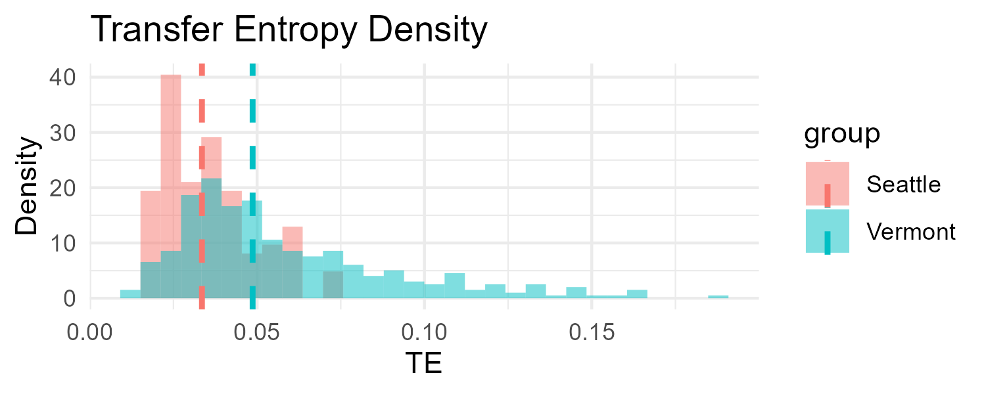
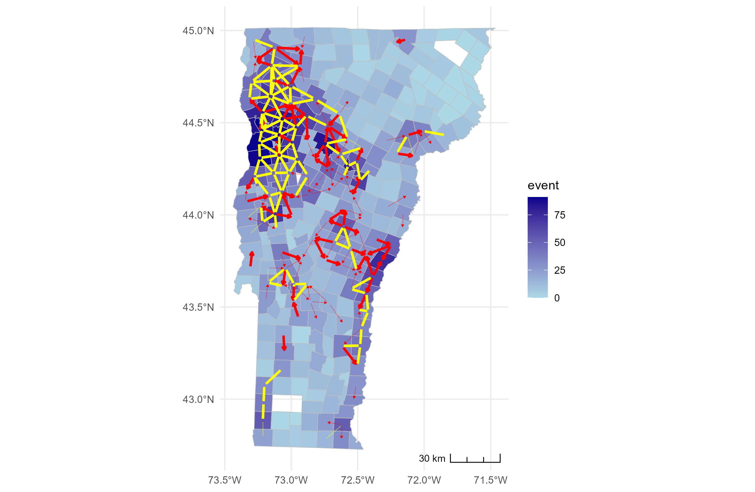
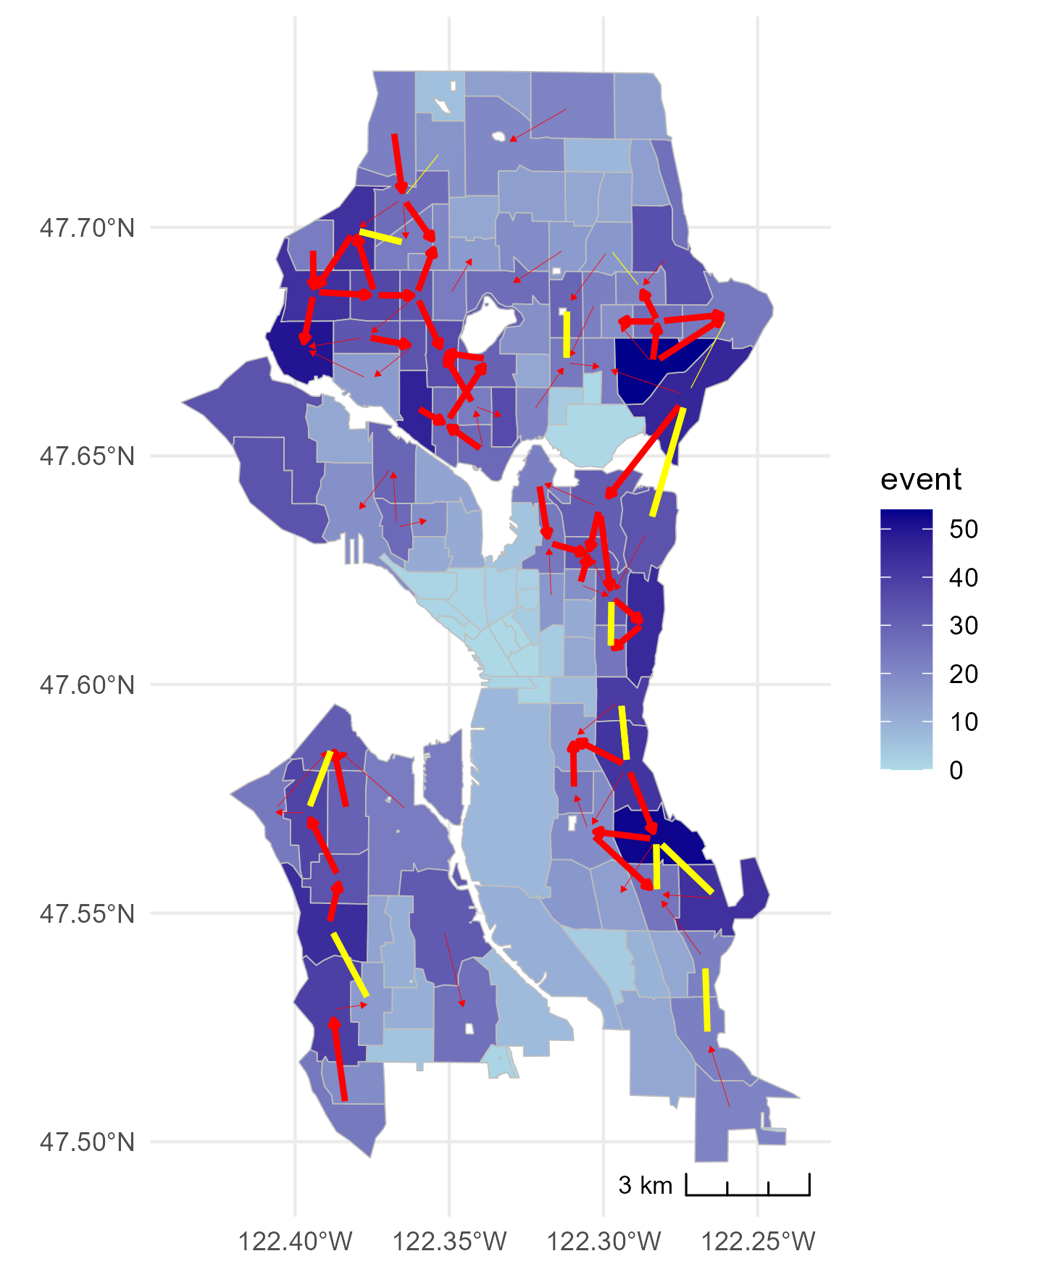
One-way causal flow with high TE
One-way causal flow with low TE
Two-way causal flow with high TE
Two-way causal flow with low TE
Vermont
Tract #: 248
One-way: 118
Two-way: 106
Network density: 0.004 (eff: 0.012)
Mean deg: 0.90 (eff: 1.66)
Clustering coeff.: 0.37
Gini coeff.: 0.67
Lorenz asym. coef.: 0.71
Hoover index: 0.53
Seattle
Tract #: 135
One-way: 69
Two-way: 16
Network density: 0.005 (eff: 0.015)
Mean deg: 0.66 (eff: 1.14)
Clustering coeff.: 0.21
Gini coeff.: 0.60
Lorenz asym. coef.: 0.71
Hoover index: 0.48

Slide 3
Total causal network
Signif. codes:
0 ‘***’ 0.001 ‘**’ 0.01 ‘*’ 0.05 ‘.’ 0.1 ‘ ’ 1
 | Estimate | sig.
Network Structure
edges | -6.07E+00 | ***
mutual | 4.24E+00 | ***
transitiveties | 9.52E-01 | ***
cyclicalties | 2.77E-01
Tract attribute
Population | 5.63E-05 | ***
SingleFamily | -8.33E-02
Income | 7.83E-06 | ***
Wealth | 8.22E-02
Homophily
Population | -7.53E-05 | ***
SingleFamily | 8.21E-01
Edu | -1.80E+00 | ***
Income | -1.26E-05 | **
Wealth | -1.80E+00 | .
Causal network in green cluster
 | Estimate | sig.
Network Structure
edges | -4.50E+00 | **
mutual | 4.12E+00 | ***
transitiveties | 4.85E-01 | *
cyclicalties | 4.84E-01 | *
Tract attribute
Population | 6.32E-05 | ***
SingleFamily | 2.13E-01
Income | 6.45E-06 | .
Wealth | -6.28E-01
Homophily
Population | -8.78E-05 | ***
SingleFamily | 6.47E-01
Edu | -2.10E+00 | ***
Income | -9.94E-06 | .
Wealth | -2.73E+00 | *
Causal network in orange cluster
 | Estimate | sig.
Network Structure
edges | -5.07E+00 | *
mutual | 2.53E+00 | ***
transitiveties | 9.43E-01 | ***
cyclicalties | 2.57E-02
Tract attribute
Population | 7.18E-05 | *
SingleFamily | -4.13E-02
Income | 4.51E-06
Wealth | 3.89E-01
Homophily
Population | -8.71E-05 | .
SingleFamily | 6.39E-01
Edu | -1.02E+00
Income | -8.54E-06
Wealth | 3.01E-01
One-way causal flow with high TE
One-way causal flow with low TE
Two-way causal flow with high TE
Two-way causal flow with low TE

Slide 4
Signif. codes:
0 ‘***’ 0.001 ‘**’ 0.01 ‘*’ 0.05 ‘.’ 0.1 ‘ ’ 1
Total causal network

Slide 5
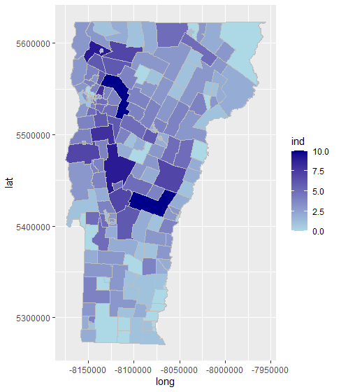
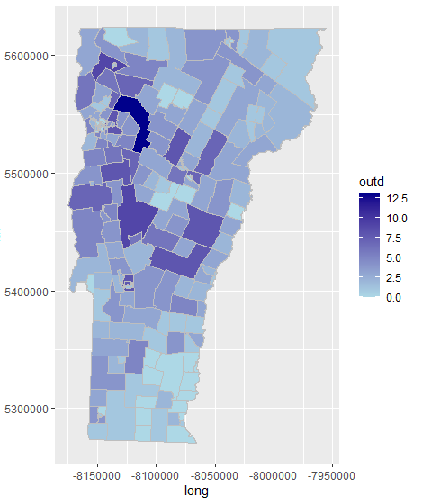
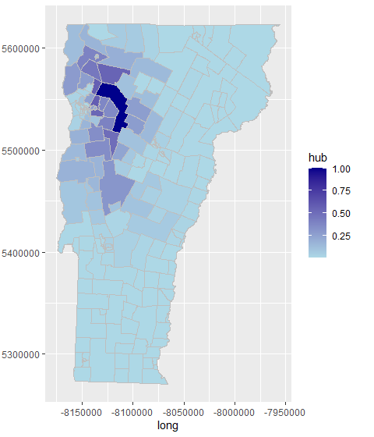
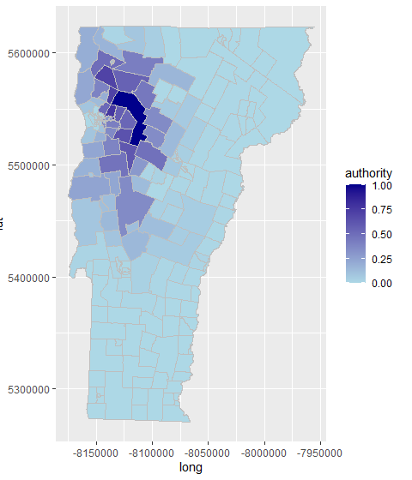
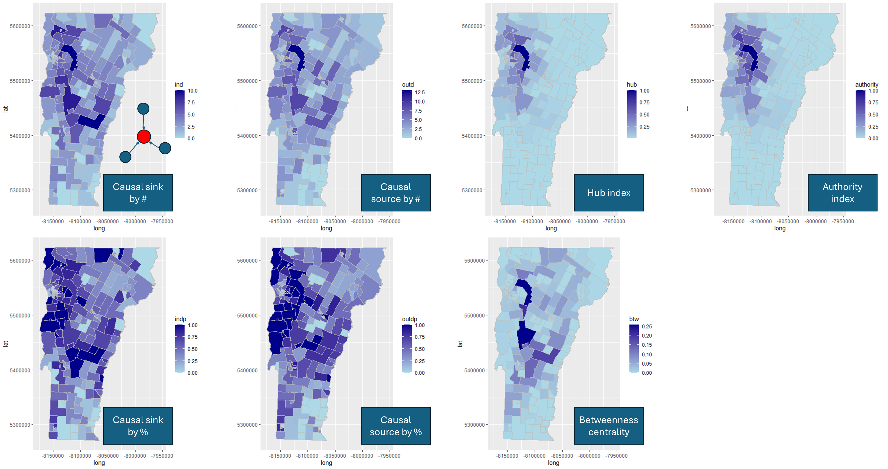
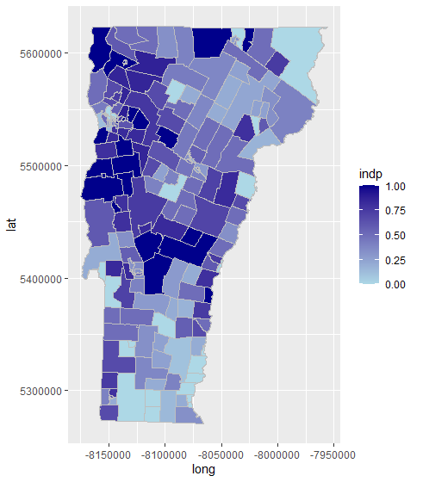
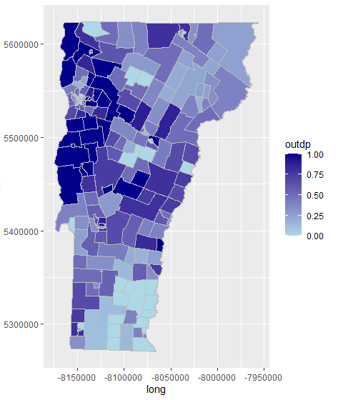
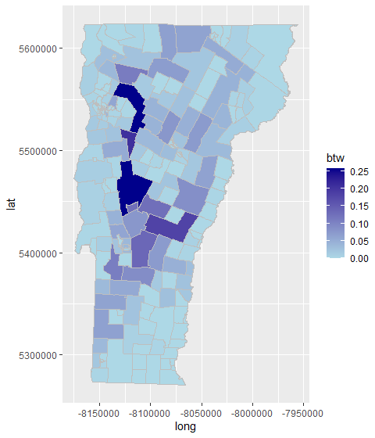
Causal sink by #
Causal source by #
Hub index
Authority index
Causal sink by %
Causal source by %
Betweenness centrality

Slide 6
